Slide 1



IOT ENABLED ENVIRONMENTAL AIR POLLUTION MONITORING AND
REROUTING SYSTEM
Team: Vimalraj S
Kanish Nisant K S
Esakkiprasath N
Abinesh R

Slide 2

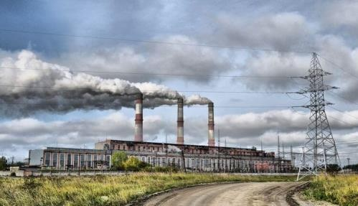
Overview
A quarter of India's population is exposed to Air pollution levels, which is a major cause of serious health issues.
Air pollution occurs when some harmful substances(CO, CH₄) are introduced in atmosphere.
The liberation of pollutants into the air can be done by petroleum emissions, chemicals from factories, dusts, pollens and mold spores.

Slide 3

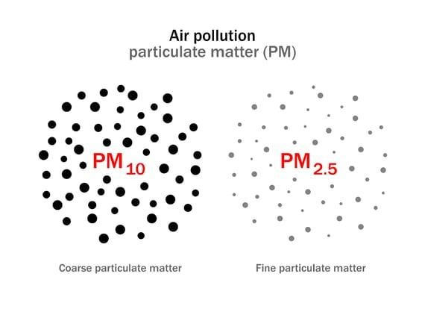

Air quality index
It is a measure of how air pollution affects one's health within a short time period.The air quality index is based on measurement of particulate matter (PM2.5 and PM10), ozone O ₃ , NO ₂
,SO ₂ ,CO present in the atmosphere
Poor quality of the AQI can lead to various respiratory problems like lung tumours, bronchitis, asthma and also other causes like eye irritations and cardiovascular issues.

Slide 4

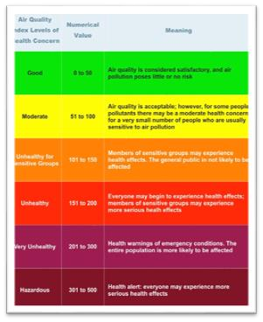

POLLUTION LEVELS AND HEALTH BREAKPOINTS
If the value of AQI is ranging from 0 to 50, it indicates the air quality is good.
If the value of AQI is ranging from 51 to 100, it indicates the air quality is satisfactory.
If the value of AQI is ranging from 101 to 200, it indicates the air quality is moderately
polluted.
If the value of AQI is ranging from 201 to 300, it indicates the air quality is poor.
If the value of AQI is ranging from 301 to 400, it indicates the air quality is very poor.
If the value of AQI is ranging from 401 to 500, it indicates the air quality is severe for health.

Slide 5

Idea proposal
In order to avoid a travel through a polluted environment, a low cost wireless air pollution monitoring system is developed in this work to measure the levels of polluted gases and update the information in Google maps which can help the passengers to reroute their journey based on low polluted area.
Different types of sensors are used to analyze and transmit the processed AQI data.
A web based application is developed with Google map API, where the status of the pollution is regularly updated.
A Neural Network with Multilayer Perceptron is used for rerouting through Machine learning algorithm.

Slide 6
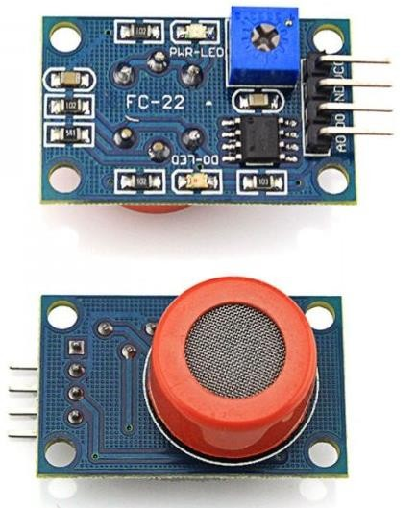
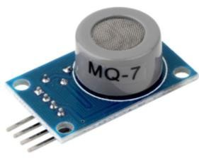
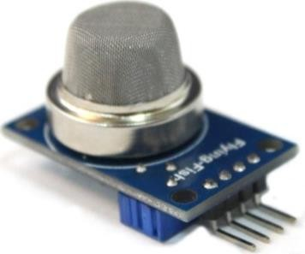
Components used:
Raspberry Pi 3
NB – IOT module
Optical dust sensor module
MQ131 – Ozone sensor
MQ7 – CO sensor
Electrochemical SO2 sensor

Slide 7
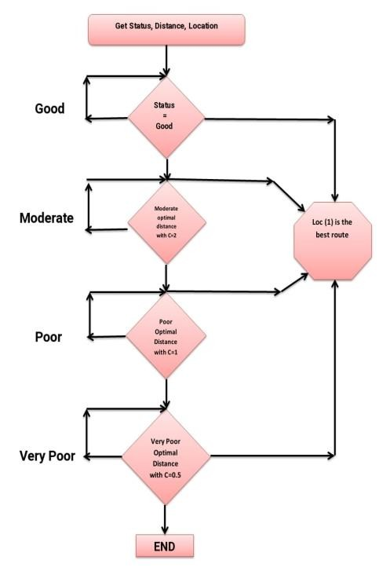
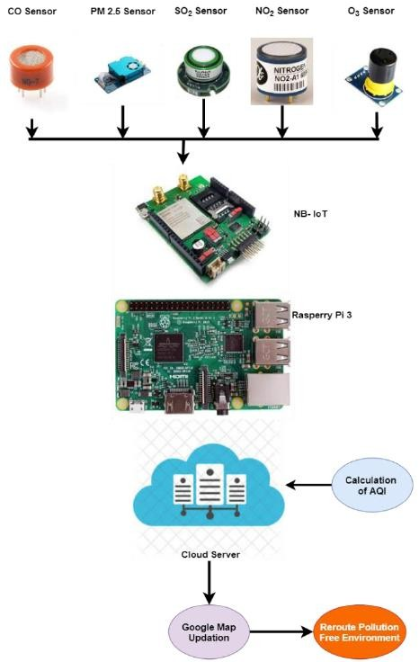
TECHNOLOGY STACK & USE CASE

Slide 8
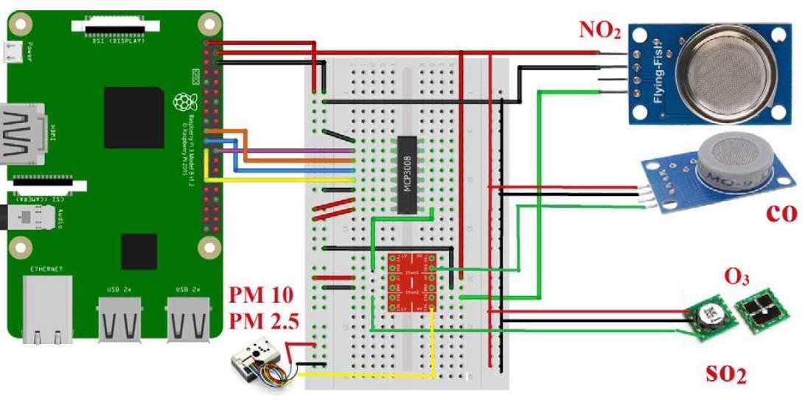
CIRCUIT DESIGN

Slide 9

SYSTEM ARCHITECTURE :
an optical dust sensor module which transcends the dust particles in air by the
transmission of light.
MQ131 Ozone Sensor detects and measures Ozone (03) Concentration from 10ppb to 2ppm.
MQ7 is low cost sensor which is able to measure the concentration of carbon
monoxide in air.
110-602 Sulphur dioxide electrochemical sensors is used to you send the amount of gas mixed with air and it provides easy integration into wireless solution.

Slide 10

DESIGN AND IMPLEMENTATION
✗ NB-IOT Transmission Module:
✗ Narrowband IoT (NB-IoT) is based on 4G LTE networks. The
information obtained through sensors is transmitted to the network b
using the narrow band device.
✗ Processing of Data:
The data from narrow band IoT devices transmit unstructured signals
via an LTE network along with OFDMA and SCFDMA signal waveforms.
WISE-4000 wireless sensor node support MQTT open communication protocol, which transmits data to clouds. By pre-integration with MQT protocol, NB-IoT nodes can integrate with cloud services automatically reducing setup complexity for rapidly implementation.
y
T
,

Slide 11
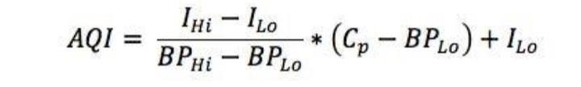
AQI FRAMEWORK
✗ The following formula is used to convert measured
pollutant concentrations to an AQI:
AQI = the AQI for the pollutant
Cp = the rounded concentration of the pollutant
BPHi = the breakpoint that is greater than or equal to Cp
BPLo = the breakpoint that is less than or equal to Cp
IHi = the AQI value corresponding to BPhi
Ilo = the AQI value corresponding to BPLo

Slide 12
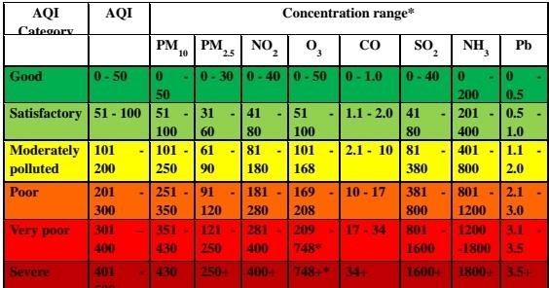
CONCENTRATION RANGE OF POLLUTANTS

Slide 13
UPDATION IN GOOGLE MAPS AND REROUTING
✗ The estimated air quality index from each area is updated in google maps using an API from Google map.
✗ The air quality index has been estimated by time series prediction analysis using neural network and support vector machine regression algorithms.
✗ In order to predict the AQI value it’s necessary to estimate the activation function using multilayer perceptron which was chosen as an approximate sigmoid for learning.
✗ Vector machine regression algorithm is used to minimize the error tolerated by individualizing the hyperplane which maximizes the margin.
✗ To perform the mapping implicitly, the kernel function maps the data into higher dimensional space kernel function.
✗
✗
✗
✗

Slide 14
RESULT AND DISCUSSION
✗ In this paper, to monitor the air pollution we have developed a model in which
the quality of air is measured by placing 5 different sensors in order to
✗ According to international standards the quality of air is measured by its air quality index value.
estimate the Pollutants present in air.
✗ So from these parameters the AQI values are estimated.
✗ As mentioned in the paper there are 6 different classifications for AQI
category starting from good to severe air pollution.
✗ The particulate matter varies from 0 to 50, nitrogen oxide varies from 0 to 40,
ozone where is from 0 to 50, carbon monoxide varies from 0 to 1.0 and
Sulphur dioxide where is from 0 to 40. This is based on 24 hour average concentration.

Slide 15

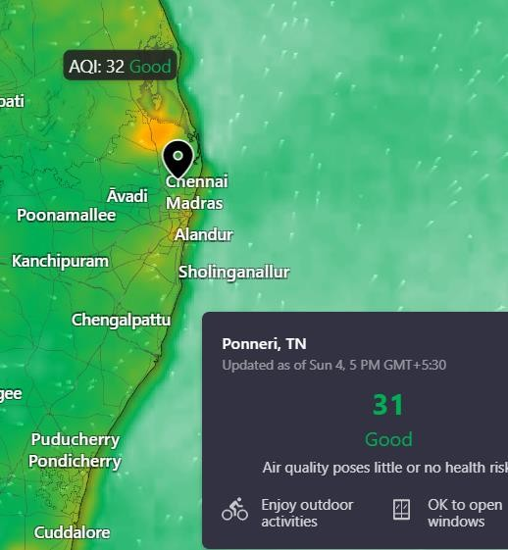
CONCLUSION
In this Project, to monitor the air pollution we have developed a model in which the quality of air is measured by placing 5 different sensors in order to estimate the Pollutants present in air, and Air Quality index is Estimated.
A proper Rerouting system is provided to the users by machine learning Algorithm. Hence users can afford a healthy travel with minimum polluted Areas.

Slide 16
REFERENCE
✗ K. B. Shaban, A. Kadri, and E. Rezk, “Urban air pollution monitoring system with forecasting models,” IEEE Sens. J., vol. 16, no. 8, pp.
2598–2606, 2016, doi: 10.1109/JSEN.2016.2514378.
✗ M. Korunoski, B. R. Stojkoska, and K. Trivodaliev, “Internet of Things Solution for Intelligent Air Pollution Prediction and Visualization,” EUROCON 2019 – 18th Int. Conf. Smart Technol., pp. 1– 6, 2019, doi: 10.1109/EUROCON.2019.8861609.
✗ S. Duangsuwan, A. Takarn, and P. Jamjareegulgarn, “A Development on Air Pollution Detection Sensors based on NB-IoT Network for Smart Cities,” Isc. 2018 – 18th Int. Symp. Commun. Inf. Technol., no.
Iscit, pp. 313–317, 2018, doi: 10.1109/ISCIT.2018.8587978.

Slide 17
Thank you
16

